Slide 1
Lessons From the Action After the Call for Renewing the Call to Action
LCLD’s First Decade and the Future of Leadership on Legal Diversity
Professor David B. Wilkins, Harvard Law School
LCLD’s 10th Anniversary Meeting
Washington, DC
September 24, 2019

Slide 2
Has it Really Been Ten Years?
In 2009, a group of legal visionaries including Rick Palmore and Robert Grey founded LCLD
Those who joined the organization were asked to sign a pledge committing them to “build effective programs in our organizations for hiring, developing, retaining, and promoting diverse talent;” to “share information with each other regarding best practices,” and to “craft incentives that reward [legal organizations] who positively distinguish themselves on diversity”
In November 2010, LCLD convened the first meeting of the GCs and managing partners who signed up for this commitment
I was honored when Rick and Robert asked me to deliver the inaugural keynote at this first meeting
It was an impressive gathering of leaders – although not National Portrait Gallery impressive if you know what I mean!

Slide 3
A Bold Move
The timing of that first event was audacious – but also auspicious
In 2009, the legal profession was in the midst of the deepest recession in its history – where, as we later documented, law firms were actively engaged in their own version of “last hired-first fired.” See Nelson, Dinovitzer, Headworth and Wilkins, Diversity in Practice: Race Gender and Class in Legal and Professional Careers (Cambridge 2016) (documenting that minorities and women were more likely to be laid off during the recession and less likely to find comparable jobs)
Yet, as Rahm Emanuel had famously said after Obama won in 2008: “Never let a good crisis go to waste!”
Global competitiveness was driving a new “partnering” model between companies and firms that was placing an increasing premium on human capital development and retention
The kind of client/law firm collaboration model pioneered by LCLD, as I wrote a decade earlier, was both a driver – and a potential beneficiary – of this development. See Wilkins, Do Clients Have Ethical Obligations to Lawyers? Lessons From the Diversity Wars (Geo. J. of Legal Ethics 1998),
To capture this benefit, however, diversity efforts must be as rigorous and metric driven as other priorities

Slide 4
Which Would Require More than Words
In 1988, GM’s GC Harry Pearce wrote a letter urging law firms to employ “minority lawyers at the requisite level of experience on all GM matters”
In 1999, Charles Morgan, GC of Bell South, authored a letter eventually signed by over 350 GCs urging companies to use their purchasing power to increase diversity
In 2004, Sara Lee’s GC Richard Palmore issued a “Call to Action” eventually signed by more than 100 leading GCs pledging to increase spending with firms that make progress on diversity – and to “end or limit” their relationship with firms that do not
And yet, notwithstanding all of these proclamations, my research underscored that diversity was still a “second order” priority for many GCs

Slide 5
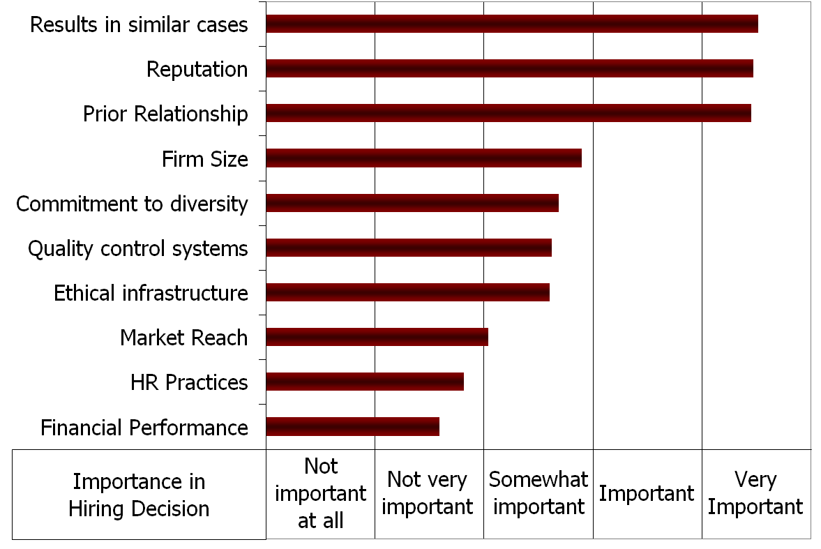
What GCs Look for When They Hire for “Important” Work (Wilkins and Kim: Diversity in Practice, 2016)

Slide 6
LCLD Has Helped to Change this Perception – and to Push the Reality as Well
In 10 years, LCLD has grown to over 300 GCs and MPs
Through its incredibly gifted professional staff and cadre of committed volunteers, LCLD has created incredible programs that have both raised the visibility of diversity issues – and more importantly of talented women and minorities throughout the profession, including:
LCLD Fellows Program, which is indeed producing “a generation of attorneys with strong leadership and relationship skills who are committed to fostering diversity “
LCLD Pathfinders Program, providing diverse attorneys with critical professional networks, leadership skills, and career strategies at the pivotal early stage in their career when so many leave law firms for other opportunities
LCLD 1L Scholars and Success in Law School Mentoring programs, designed to increase the pipeline of talented women and minorities entering the profession
What’s Working, information service highlighting member initiatives and best practices
I have witnessed the value of these programs and the dedication of those who participate in them at the LCLD Annual Leadership Summit we host at HLS

Slide 7
And it’s Not Just LCLD
Feb 2017: HP GC Kim Rivera tells law firms to “meet diversity goals or forfeit up to 10% fees”
Jan 2019: 170 GCs signed a letter promising that “we as a group will direct our substantial outside counsel spend to those law firms that manifest results with respect to diversity and inclusion”
Feb 2019: AdvanceLaw, a network of 250 GCs that share performance data on star lawyers, launched a diversity mentoring program to “build relationships between rising diverse law firm associates and chief legal officers and other senior in-house lawyers”
Sept 2019: Diversity Lab, along with 25 GCs, 5 law firms, and dozens of other industry thought leaders launched The Move the Needle Project, promising to invest $5M to “test innovative initiatives to create a more diverse and inclusive legal profession”

Slide 8
Backed by Empirical Evidence on “Why Diversity Works”
As the optimistic title of McKinsey’s 2015 Report underscores: “new research makes it clear that companies with more diverse workforces perform better financially”
In 2018, McKinsey claimed in “Delivering Through Diversity” that since its first Report, “we have seen a growing awareness of the business case for inclusion and diversity”
There is similar evidence specifically about the legal profession
In 2016, Acritas issued a Diversity Report subtitled “Statistical Proof that Having a Diverse Team Leads to Better Performance”
Based on research on over 1700 companies, Acritas concluded that GCs who work with “very diverse” teams vs. teams that are “not diverse” have significantly better experiences, and are therefore: 3X more likely to promote the firm to others; 1.5X more likely to give the team a perfect 10 of 10 for performance; give 25% greater “share of wallet” over time

Slide 9
The World is Changing Too
The baseline: The “good old days”:
Wall Street law firms recruits men who are “Nordic, have pleasing personalities and ‘clean cut’ appearances, are graduates of the ‘right’ schools, have the ‘right’ social background and experience in the affairs of the world, and are endowed with tremendous stamina.” (Erwin Smigel, The Wall Street Lawyer, 1969)
Today, there are not enough clean cut Nordic guys to go around!
More than 50% law students are female – more outside of the U.S.
20% of students are people of color – more diversity when one considers other forms of diversity, including LGBTQ and people with disabilities
Indeed, the U.S., will be a “majority minority” country by 2045
And both companies and law firms increasingly operate in a global environment, requiring globally qualified workers from a variety of disciplines to collaborate effectively to produce value
Yet lawyers still divide the world into “U.S.” and “foreign” offices, “law firms” and “alternative providers,” and worst of all “lawyers” and “non-lawyers”!

Slide 10
And Yet, the More Things Change…
Over two decades ago, I published Why are there So Few Black Lawyers in Corporate Law Firms? (84 Cal. L. Rev. 493 1996) – the first article in a major law journal to seriously address the topic
The article sought to explain why more than four decades after Brown, black lawyers still constituted less than 2% of associates, and less than 1% of the partners in the nation’s 250 largest law firms
Since 1996, there have been many notable changes in our country – not the least of which is the election of the country’s first black President, whose portrait many of us saw last night
But after rising slowing for a decade, black associates have fallen from 4.6% to 3.9% since 2009 – with the number of black partners holding at just 2% since 2012 (with some current estimates as low as 1.8%), and only very modest gains in the numbers of both Asian and Hispanic partners in top firms (2.7-3.3% for Asians, 2.3-2.6% Hispanics)
And least one thinks that this is only a matter off time, women have been more than 40% of entering associates since 1986, but still are less than 20% of partners

Slide 11
Nor is the Legal Profession Unique
In all US companies with more than 100 employees, percentage of black managers only rose from 3-3.3% from 1985-2014
And while the percentage of white female managers in these companies rose from 22-29% between 1985-2000, almost no increase since
Even McKinsey admits in its 2018 Report that since 2015, the companies it survey only increased gender representation on executive teams by 2% (to 14%) and minority and ethnic representation by 1% (to 13%)
Moreover, many of the programs that have been instituted to increase diversity do not appear to be working
See Dobbin and Kalev (HBR 2016) Why Diversity Programs Fail (arguing that diversity training can “activate bias rather than stamp it out”)
See Padvic, Ely, and Reid (ASQ 2019) Explaining the Persistence of Gender Inequality: The Work-Family Narrative as a Social Defense against the 24/7 Work Culture (arguing that flexible work policies designed to help women do not improve gender diversity and may hurt women)
See Russel Reynolds (Forbes March 2019) Chief Diversity Officers are Set up to Fail (arguing that CDOs are systematically not given the support they need to do their jobs)

Slide 12
And Changes in Law Firms and Legal Departments are Likely to Exacerbate these Problems
Law Firms
Recruiting: Shift from entry level to laterals
Less process, greater emphasis on personal relationships, and higher perceived stakes
Retention: Shift from apprenticeship to performance
Shorter time horizon, more hours pressure, and increased ambiguity about performance metrics
Partnership: Shift from (quasi) tenure to tenuous
Increased emphasis on short term, individual revenue generation
Companies
In-house legal departments, which used to be the fastest growing segment in the legal profession, are flat or declining – and are increasingly being required to do more with less
Growing pressure on hours and compensation
Internal structures are relatively flat, providing less opportunity for advancement

Slide 13
As are Changes in Who is Going to Law School
Law School enrollment is down from around 140K in 2007 to just over 110K in 2018
Moreover, this decline is not evenly distributed across all groups (Goodwin Liu, et al., A Portrait of Asian Americans in Legal Education, forthcoming)
Asian American enrolment has declined by 37.6% -- significantly more than any other group
And while black enrolment has declined less steeply (by 11.2%), and Latinx enrolment has actually increased significantly (18.18%), more than 50% of black and Hispanic students attend law schools in Tiers 4 and 5 – or which are not ranked at all – where few law firms or legal departments recruit
And for all minority groups – and for all groups since 2016 – the majority of these new lawyers are women
Although this represents a triumph for gender inclusiveness, it also presents a challenge for a profession that remains gender challenged – particularly for women of color, who have all the problems that minority men and white women have, plus a unique combination of the two

Slide 14
Current Job, Initially Private by Gender
Even though black women law firms at the same rate after graduation, men are overwhelmingly more likely to still be working in this sector than women
Women are significantly more likely to be working in public interest
Overall, these patterns are not good news for those seeking to improve the dismal numbers for black women advancing to partnership and leadership in law firms

Slide 15
Gender and Leadership
In virtually every leadership category, black women are overwhelmingly less likely than black men to have had these opportunities
92% of all black graduates who have been managing partners or department chairs are men
87.5% of those who have ever chaired the management committee are men
Indeed, 79.1% of those who have ever served on the management committee – and 89.3% of those who have served on the compensation committee – are men
These results mirror – but are even more extreme – than what we found in HLSCS, where women were significantly less likely than men to have had important leadership roles
Clearly, black HLS female graduates continue to encounter significant obstacles in obtaining leadership positions in law firms – notwithstanding the fact that they join large law firms at rates that are significantly higher than black men (and HLS graduates generally)

Slide 16
And While They Put Up with Disadvantage, They Wouldn’t Recommend it to Others
Would Still Attend Law School?
These results are consistent — indeed, even slightly more positive — than our findings in HLSCS, where 85.7% of all HLS graduates reported that they would still obtain a law degree today.
Would Recommend Law to a Young Person
Although nearly 90% of respondents indicated they personally would still obtain a law degree, only 66.2% reported that they would recommend it to a young person
Like career satisfaction, the percentage of those who would recommend law as a career has been declining over time.
Male respondents were much more likely to recommend law to a young person than female respondents

Slide 17
And the Population of Law School Graduates is About to Get Even More Complex
The percentage of law students who identify outside the four traditional racial groups (including those who identify as multiracial, non-resident alien, or race unknown) has risen from 5% - 12% in twenty years (Liu et al., forthcoming)
This is particularly true in elite law schools, where the percentage of such students is approaching 20%
In our Black Alumni Survey, 17.9% of respondents stated that their primary identity was other than Black/African American, with the majority of recent graduates identifying as African or Multiracial
In a very important sense, this represents a significant accomplishment in a society in which interracial marriage was against the law until 1964 – and where as late as 2013 an interracial couple on a Cheerio’s commercial created a storm of protest
Now it seems like EVERY couple on TV is interracial – and Blackish has become Mixedish
But in many discussions with diversity professionals, this trend also raises complications for who we are trying to serve and how we serve them, in a world in which the traditional categories still matter

Slide 18
And the Changes in the Legal Profession in the Coming Years will be Even More Momentous than in 2009
Lots of discussion about “legal start-ups” and “Robot Lawyers”
But these discussions both understate and overstate the state of change in the legal profession – and indeed the entire economy
They understate because the issues facing lawyers are part of a far bigger set of changes transforming the way that we increasingly see, understand, and consume the world:
Globalization of economic activity
Rise in the speed and sophistication of information technology
Blurring of traditional categories of organization and thought
But they overstate the degree that the practice of law will – and should – change in the foreseeable future
The future of legal work will be shaped by both of these forces – and the interplay between them
Our ability to continue to make progress on diversity depends on understanding this complex interaction

Slide 19
The New Normal for Lawyers
Both law firms and legal departments have increasingly sophisticated clients with more access to information – and who are demanding more transparency from lawyers
Forcing efficient unbundling and repackaging of services and a move toward “value” billing
All of this puts pressures on the legal profession’s historic models:
Business model: hourly billing driven by leverage
Human capital model: only “lawyers” can provide legal services
Knowledge management model: Go to the library or ask the senior partner
Education model: three years of learning how to think like a (18th century common law) lawyer
How will diversity advocates respond to this “disruptive innovation”?

Slide 20
But Legal Services Will Not – and Should Not – Be Completely Disrupted
Law – at least for the foreseeable future – remains a human capital business
How will we train the next generation of lawyers in a world in which even disrupters (and certainly in-house legal departments) depend on law firms to train new lawyers?
Clients continue to want “relationships” with firms (for “important” work)
A new wave of convergence around the world, particularly as issues such as cyber security and data protection highlight the interdependence of lawyers and clients
Tradition and stability continue to have important value for lawyers and clients
Law and lawyering linked to fundamental goods that will never be deregulated completely – the essence of the “Rule of Law”
This is precisely what will attract the best and brightest to want to be lawyers
How do we demonstrate the value of diversity in a world shaped by the interplay between these traditional forces and the imperatives of the future of work?

Slide 21
A Tale of Two Futures
Pessimistic story: last hired first fired
As low end work disappears, minorities will be first to go
At the same time, 24/7 work day will increase pressures on women – which in turn adversely affects minorities
Intensified by attrition, layoffs, mergers, and failures
Optimistic story: Speed skating not figure skating
GC’s increasingly metric driven to achieve more for less
Decreases the importance of relationships – except where relationships confer value
Value is increasingly created through networks that span traditional boundaries

Slide 22
A Few Points of Light From Across the Pond
2014: Clifford Chance adopts “CV Blind” policy for final interviews to break “Oxbridge” recruitment bias
2017: A&O launches Leadership Center: “to develop and support future leaders whether their futures lie within or outside of the firm”
2018: Clifford Chance begins piloting a program to eliminate “utilization” as a criteria for associate evaluation with the goal of incentivizing teams to spend time on the firm’s “innovation strategy” and encouraging “professional development,” “diversity,” and “wellness”
And in 2020, a major global firm is planning on eliminating law school grades in hiring in favor of criteria linked to experience and grit, such as whether the candidate has worked in a service job, learned a foreign language as an adult, plays an instrument, or studied design thinking

Slide 23
But Yankee Ingenuity is Working Too
In 2017, Diversity Lab pioneered The Mansfield Rule promising that 30% of candidates for leadership positions will be minorities and women
In two years 64 firms have signed on, producing impressive results with respect to the percentage of diverse lawyers promoted to equity partner, appointed to important leadership positions, and hired laterally
Institutional interventions:
De-biasing institutions not individuals
Creating institutional “nudges” that correct for unconscious bias through rigorous data collection and targeted intervention (Paola Cecchi-Dimeglio)
What gets measured gets done – and gets valued
ABF RGLD: Metrics, Diversity, and Law
HLS CLP: Quality Metrics in Law

Slide 24
LCLD at 20
Whether these pilot projects and the renewed attention to diversity will produce real change remains to be seen
Research suggests that one of the most important things that any organization can do to drive diversity is to put someone in charge of the effort – and hold them accountable
See Dobbin (2017) (dedicated diversity professionals produce increases in the number of women and minorities that range from 7.5%, for white women in companies that have diversity managers, to 22.7% and 30.2%, for black women and Asian men respectively for companies that have diversity task forces)
And we know that the most important determinate of whether any change management initiative succeeds is leadership at the top
Which is why an organization comprised of top leaders from the most important companies and law firms remains such a potent force for change
Which is why I can’t wait to see what LCLD accomplishes in the next 10 years – and where Rick and Robert will hold the 20th Gala
I just hope I get invited back to speak!

